Slide 1
Infosys Springboard Virtual Internship 6.0 Project
Completion Report
1.
Internship Details
Infosys Springboard Virtual Internship 6.0
  Start Date: 25-NOV-25
  Batch Number :10
2.Name:
S.No
NAME
1
RAJESWARI R
3. Project Title
Inventra – Intelligent Inventory Management System
4. Project Objective
•
Enable Intelligent Inventory Tracking – Accurately monitor product
quantities, stock movement, and availability in real time using a centralized database system.

Slide 2

•
Provide Efficient Product & Stock Management
– Support seamless addition, update,anddeletionofproductandinventory records to maintain
accurate stock information.
•
Implement Automated Inventory Alerts – Generate timely notifications
for low-stock situations to prevent shortages and ensure uninterrupted operations.
•
Support Data-Driven Inventory Decisions – Deliver clear insights
through reports and analytics such as stock summaries, usage trends, and inventory status reports.
•
Ensure Secure and Scalable System Operation – Protect user access
through authentication mechanisms while maintaining a modular architecture that supports future scalability and enhancements.
5. Project Description
Inventra – Intelligent Inventory Management System is a web-based application designed to overcome the limitations of traditional inventory systems such as manual errors, lack of transparency, and inconsistent stock records.
The system follows a layered architecture using Spring Boot and REST APIs.
It allows authenticated users to manage products, perform stock-in and stock-out
operations, and automatically records each transaction. When inventory levels
fall below a predefined threshold, the system generates alerts to notify responsible
users.
The application ensures data consistency, security, and accountability using
transaction management, JWT-based authentication, and role-based access
control. Overall, the project provides a reliable and structured solution for
inventory operations.

Slide 3
6. Technology Stack Used
• • • • • • • • • •
IntelliJ IDEA HTML, CSS, JavaScript Java Spring Boot REST API JWT BCrypt Role-Based Access Control MySQL Maven
7. Modules Implemented
Module 1: Authentication
• • •
Secure login and registration JWT-based authentication Role-based access control
Module 2: Inventory Management
• • •
Product management Stock-in and stock-out operations Duplicate product prevention
Module 3: Inventory Alerts
• •
Low-stock detection Automatic alert generation
Module 4: Transaction Management
• • •
Recording stock movements Maintaining transaction history Supporting auditing and reporting
Module 5: Reports & Analytics
• •
Generating stock and transaction reports Applying basic filters

Slide 4

•
Supporting decision making
8. Timeline Overview
Week
Activities Planned
Activities Completed
Project kickoff, team introduction, understanding inventory management challenges, and defining problem statement and objectives.
Requirement analysis and
system design planning,
including module identification
and technology stack
finalization.
Week 1
Conducted project initiation meeting, finalized project scope and objectives, and studied existing inventory management systems and workflows.
Identified core modules (Authentication,
Inventory Management, Alerts,
Reports), finalized technology stack, and
prepared system architecture and
database design plan.
Designed MySQL database
schema, created entity relationships, and implemented JWT-based authentication with secure user login and role
management. Implemented CRUD operations for
products and inventory using Spring Boot REST APIs and integrated them with the MySQL database.
Developed stock threshold monitoring
logic and implemented automated low- stock alert functionality.
Implemented inventory summary and
product-wise reports and integrated backend APIs with frontend interfaces using HTML, CSS, and JavaScript.
Week 2
Week 3
Database schema design and authentication module planning.
Week 4
Development of Product and Inventory Management modules with backend APIs.
Week 5
Inventory alert mechanism and
business logic implementation.
Week 6
Reports and analytics module
development and frontend integration planning.

Slide 5
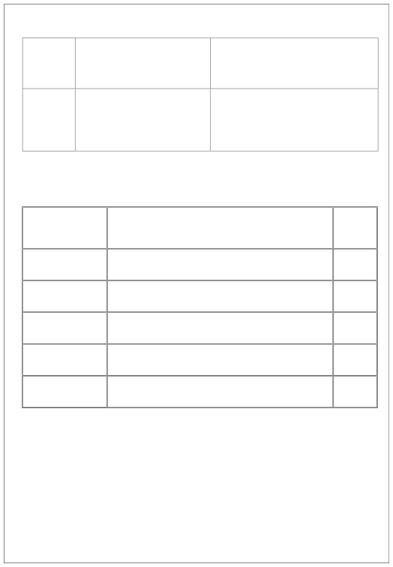
Frontend development, system integration, and testing.
Completed frontend screens, integrated all modules, and performed unit and integration testing for APIs, database operations, and alerts.
Completed system documentation,
prepared presentation slides, and
delivered final demo showcasing end-
to-end workflow from login to
inventory tracking, alerts, and reports.
Week 7
Week 8
Final testing, documentation, presentation preparation, and project demonstration.
9. Key Milestones
Milestone
Description
Date Achiev ed
26- NOV-25
04-DEC-
25
19-DEC-
25
08-JAN-
26
Project Kickoff
Team formation, problem understanding, requirement analysis, and system architecture planning
Identification of core modules, technology stack
finalization, and database schema design
Implementation of authentication, product, and
inventory management modules
Development of inventory alert mechanism and basic
reporting features
Frontend integration, testing, documentation,
presentation, and final project demonstration
Prototype / First
Draft
Mid-Term Review
Final Submission
Presentation
23-JAN-
26

Slide 6
10. Project Execution Details
The Inventra – Intelligent Inventory Management System was developed over an 8-week internship period using a structured and modular approach. The project started with requirement analysis and system design, where key issues such as inaccurate stock handling, lack of transaction tracking, and security concerns were identified. Based on these requirements, a layered architecture consisting of Controller, Service, and Repository layers was designed.
The Authentication module was implemented first using Spring Boot with JWT- based authentication and role-based access control to ensure secure access. Passwords were encrypted using BCrypt for improved security. Next, the Inventory Management module was developed to manage products and perform stock-in and stock-out operations with proper validations to prevent duplicate entries and negative stock values.
The Transaction Management module was integrated to record every inventory operation automatically. Transaction handling was implemented using Spring’s @Transactional mechanism to ensure data consistency and rollback in case of failures. The Inventory Alerts module was then added to monitor stock levels and generate alerts whenever inventory fell below the minimum threshold.
Finally, the Reports & Analytics module was implemented by generating reports from existing inventory and transaction data using basic filters. The complete system was tested for functionality and security, followed by documentation and final submission.

Slide 7
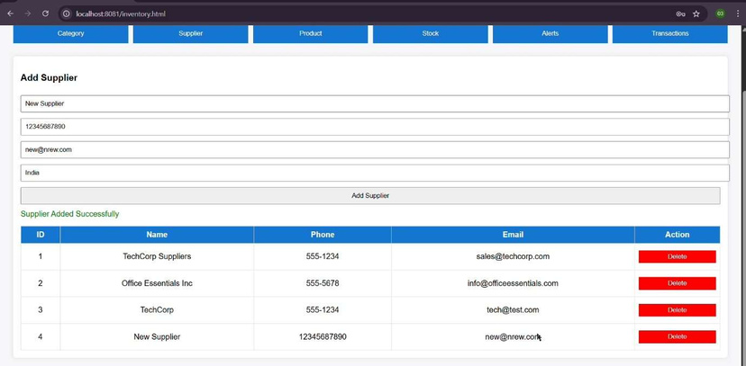
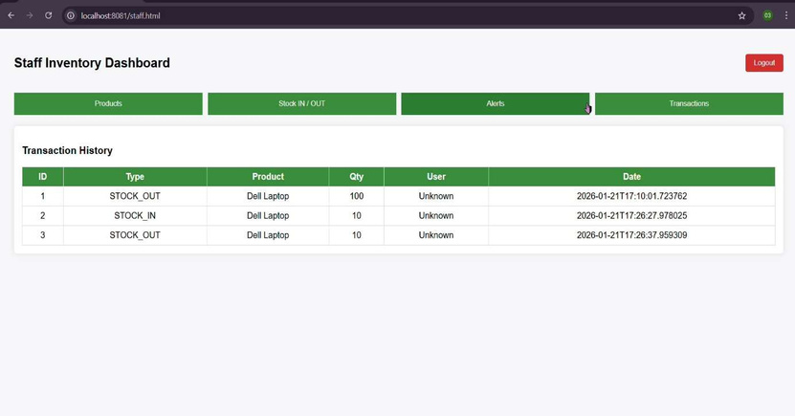
11. Snapshots / Screenshots

Slide 8
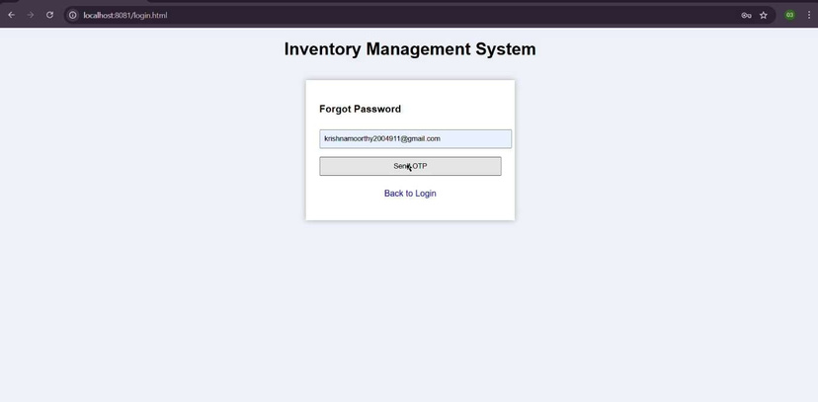
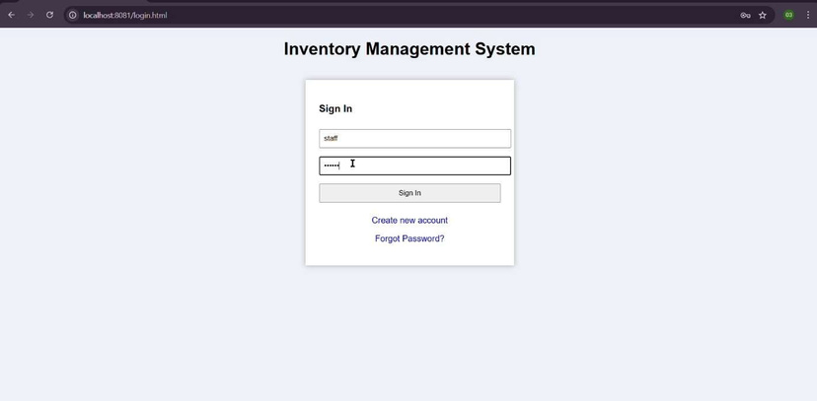

Slide 9
12.
Key Learnings & Skills Acquired
•
Gained understanding of inventory management workflows and system
requirements.
• Developed backend applications using Java and Spring Boot with RESTful
APIs.
• Learned secure authentication using JWT, BCrypt, and Role-Based Access
Control (RBAC).
• Built frontend interfaces using HTML, CSS, and JavaScript.
• Designed and managed MySQL databases with CRUD operations and data
integrity.
•Implemented inventory alert mechanisms and business logic.
•Generated inventory reports to support data-driven decisions.
•Improved testing, debugging, teamwork, and project documentation skills.
•
Learned to write unit/integration tests and optimize system latency, model
accuracy, and API performance.
•
Improved coordination, presentation skills, and project documentation habits through weekly milestone reviews.
13. Challenges Faced
• Challenge 1: Database Design for Inventory Management
Problem: Designing a database schema that efficiently handles products,
inventory levels, users, and alerts without data redundancy.
Solution: Implemented a well-structured MySQL relational schema with proper
normalization and foreign key relationships to ensure data integrity and
scalability

Slide 10
• Challenge 2: Secure Authentication and Authorization
Problem: Ensuring secure access while managing different user roles within the
system.
Solution: Implemented JWT-based authentication with BCrypt password
encryption and Role-Based Access Control (RBAC) to manage permissions
securely.
• Challenge 3: Real-Time Inventory Accuracy
Problem: Maintaining accurate stock levels during frequent inventory updates
and transactions.
Solution: Centralized inventory update logic in the Spring Boot service layer and
ensured synchronized database operations through validated API workflows.
• Challenge 4: Frontend–Backend Integration
Problem: Ensuring seamless data exchange between frontend interfaces and
backend REST APIs.
Solution: Standardized API responses and thoroughly tested endpoints to ensure
smooth integration and consistent data rendering.
14. Testimonials from team
Working on the Inventra project helped us gain practical exposure to real-world inventory management systems and strengthened our backend development skills. The project improved our understanding of Spring Boot, REST APIs, and database integration while enhancing our teamwork and coordination. Mentor guidance and collaborative problem-solving played a key role in successfully implementing secure authentication and inventory alert mechanisms. This project enhanced our confidence in building scalable, secure, and industry- relevant applications.

Slide 11
15. Conclusion
The Inventra – Intelligent Inventory Management System successfully
demonstrates the implementation of a secure, modular, and scalable inventory
solution. The project provided hands-on experience in backend development, database design, security implementation, and team collaboration. This internship significantly enhanced our understanding of real-world software development practices and industry-level application design.
16. Acknowledgement
We sincerely thank Infosys Springboard and our mentor for providing guidance, resources, and continuous support throughout the internship. Their encouragement and feedback helped us successfully complete this project and gain valuable practical experience.
------------------------------------------------------------

